Slide 1

Text Processing and Classification
presented by
Daghumati poojitha
192211732
CSA1337-Theory of computation

Slide 2
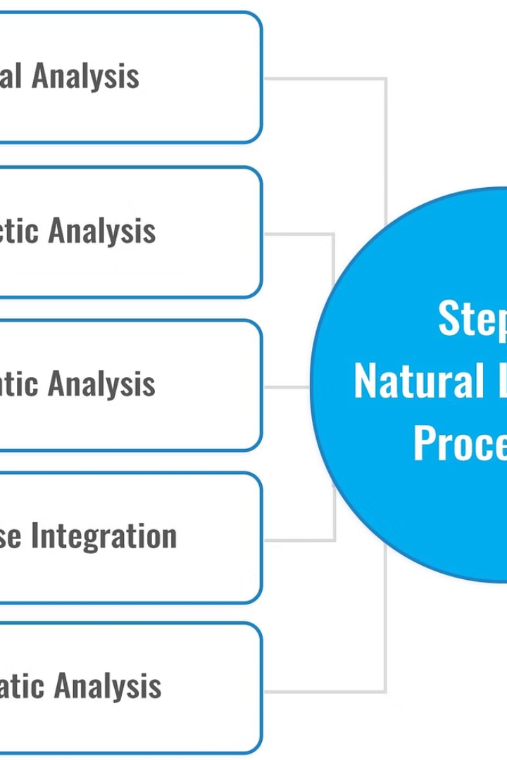
Introduction to Text Processing and Classification for Natural Language Processing
Natural Language Processing (NLP) is a rapidly evolving field that focuses on the analysis and understanding of human language. Text processing and classification are crucial components of NLP, enabling machines to comprehend, interpret, and extract insights from vast amounts of textual data.

Slide 3
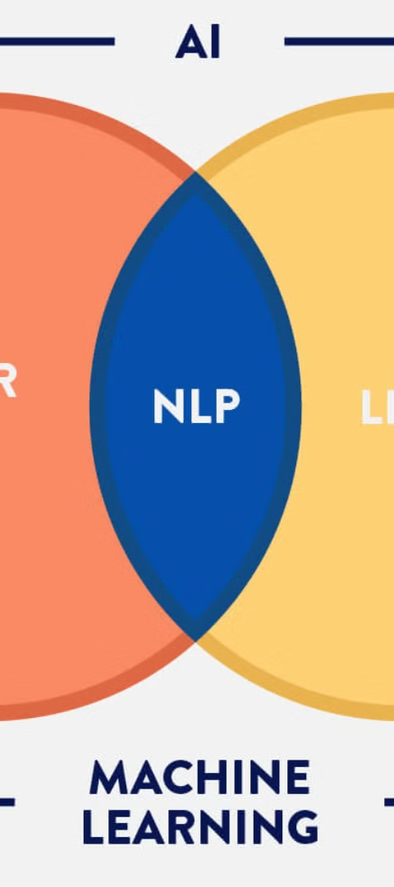
Objectives
1
Understand Text Structure
2
Classify Text Data
Develop techniques to analyze the structure and patterns within text, such as syntax, semantics, and discourse.
Design algorithms and models to categorize text into meaningful groups or classes based on content, sentiment, or other attributes.
3
Improve NLP Capabilities
Advance the field of NLP by enhancing the ability of machines to comprehend, generate, and manipulate human language effectively.

Slide 4
Problem Definition and Algorithm
Problem Definition
Algorithm Definition
Task Definition
Clearly identify the specific challenges and objectives in text processing and classification tasks, such as sentiment analysis, topic modeling, or named entity recognition.
Develop and refine algorithms, models, and techniques that can effectively address the identified problems, leveraging machine learning, deep learning, and other computational approaches.
Define the specific tasks and subtasks involved in the text processing and classification pipeline, ensuring a comprehensive and structured approach to problem-solving.

Slide 5
Experimental Evaluation- Methodology, Results, discussion
Methodology
1
Outline the experimental design, including data collection, preprocessing, feature engineering, and the selection of appropriate evaluation metrics to assess the performance of the proposed algorithms.
2
Results
Present and analyze the findings from the experimental evaluation, highlighting the strengths, weaknesses, and overall effectiveness of the developed text processing and classification techniques.
Discussion
3
Interpret the results, identify important insights, and discuss the implications of the findings for the advancement of NLP research and practical applications.

Slide 6

Related Work
State-of-the-Art Approaches
Interdisciplinary Connections
Review and summarize the latest advancements in text processing and classification techniques, including the use of deep learning, transfer learning, and other cutting-edge methodologies.
Explore the connections between text processing and classification research and other fields, such as linguistics, cognitive science, and information retrieval, to gain a broader understanding of the problem space.
Limitations and Challenges
Identify the current limitations and ongoing challenges in the field, providing a roadmap for future research and development to address these issues.

Slide 7




Future Developments and Enhancements
Multimodal Integration
Ethical Considerations
Scalability and Efficiency
Explore the integration of text processing and classification with other modalities, such as images, audio, and video, to develop more comprehensive and robust NLP systems.
Address the ethical implications of text processing and classification, including issues of privacy, bias, and the responsible use of these technologies.
Enhance the scalability and efficiency of text processing and classification algorithms to handle large-scale, real-world datasets and applications.

Slide 8



Outcomes and Implications for NLP
Business Applications
Healthcare Applications
Social Impact
Improve decision-making, customer service, and market insights through advanced text processing and classification techniques.
Enhance medical diagnosis, drug discovery, and patient care by extracting valuable information from clinical notes and research papers.
Promote social good by leveraging text processing and classification to address societal challenges, such as misinformation detection and hate speech monitoring.

Slide 9
Conclusion
1
Summary of Key Findings
2
Future Research Directions
Provide a concise summary of the critical insights and advancements presented throughout the text processing and classification research.
Outline the promising avenues for future research and development in the field of NLP, highlighting the potential for continued innovation and impact.
3
Importance of the Field
Emphasize the vital role of text processing and classification in the broader context of NLP and its significance for advancing human-machine interaction and understanding.

Slide 10
Bibliography
Manning, C. D., & Schütze, H. (1999). Foundations of statistical natural language processing. MIT press.
Jurafsky, D., & Martin, J. H. (2014). Speech and language processing (Vol. 3). London: Pearson.
Goldberg, Y. (2017). Neural network methods for natural language processing. Synthesis Lectures on Human Language Technologies, 10(1), 1-309.
Collobert, R., Weston, J., Bottou, L., Karlen, M., Kavukcuoglu, K., & Kuksa, P. (2011). Natural language processing (almost) from scratch. Journal of machine learning research, 12(Aug), 2493-2537.

